Slide 1
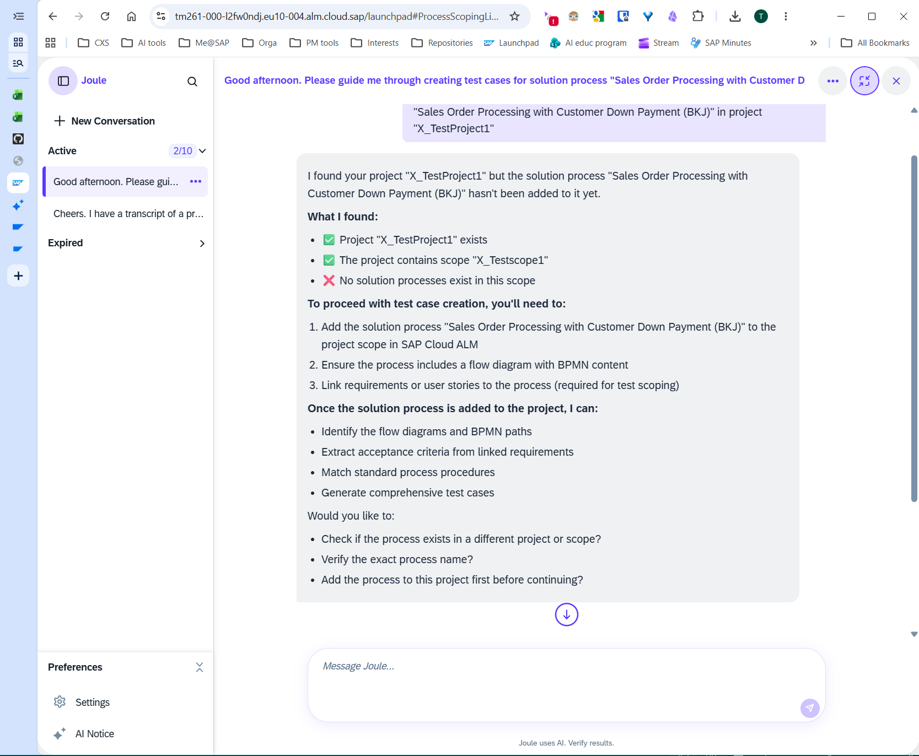
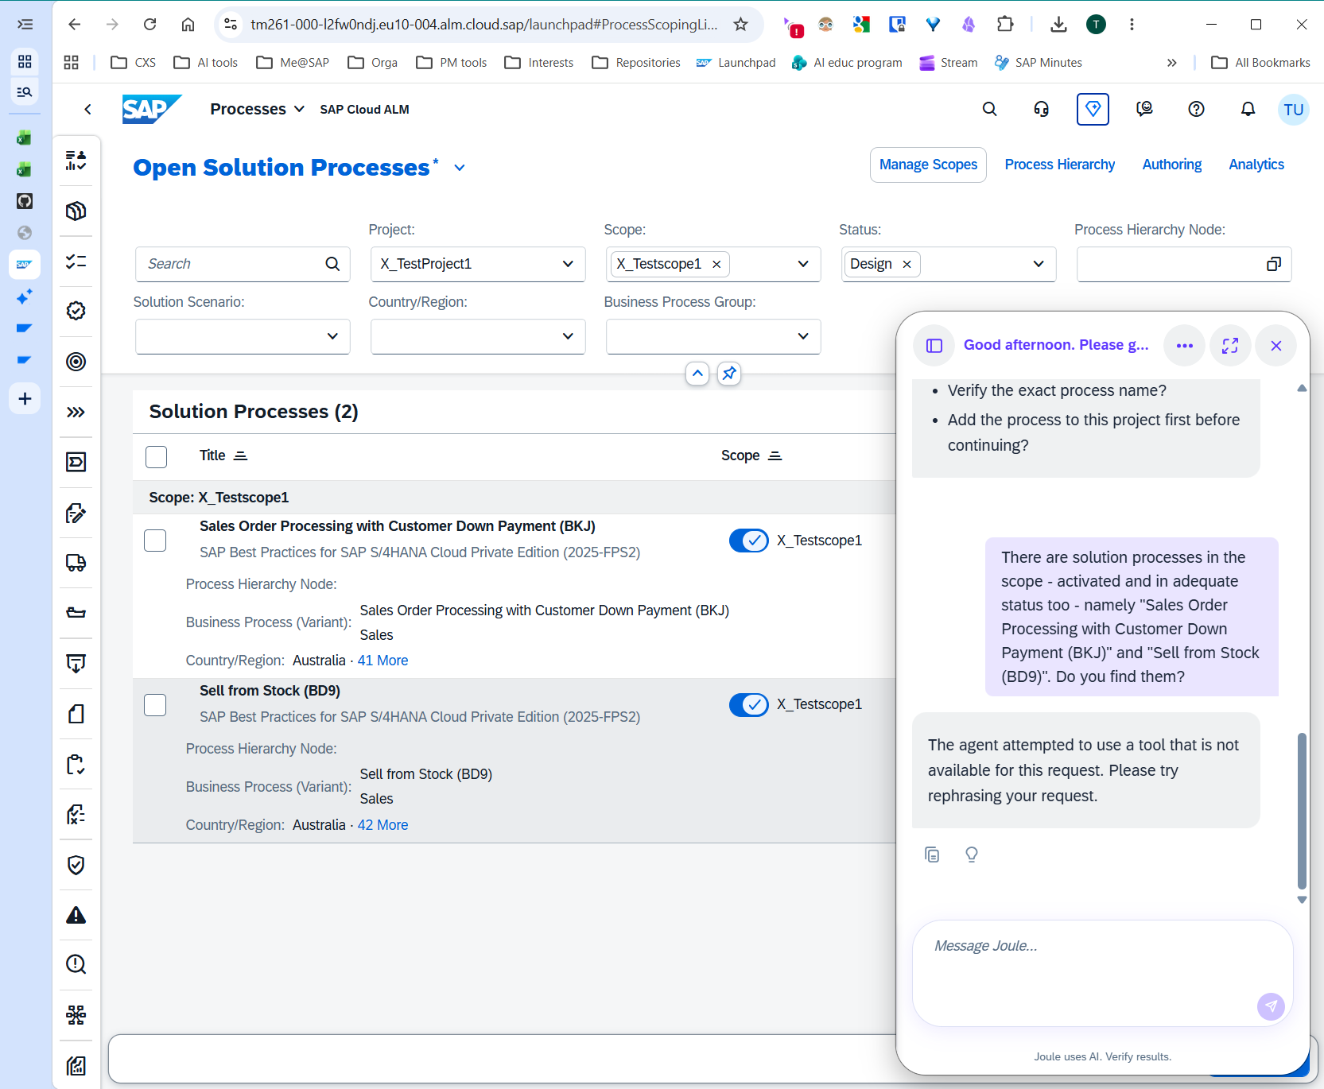
Agent doesn’t see assigned solution processes & subsequent agent response is not helpful.

Slide 2
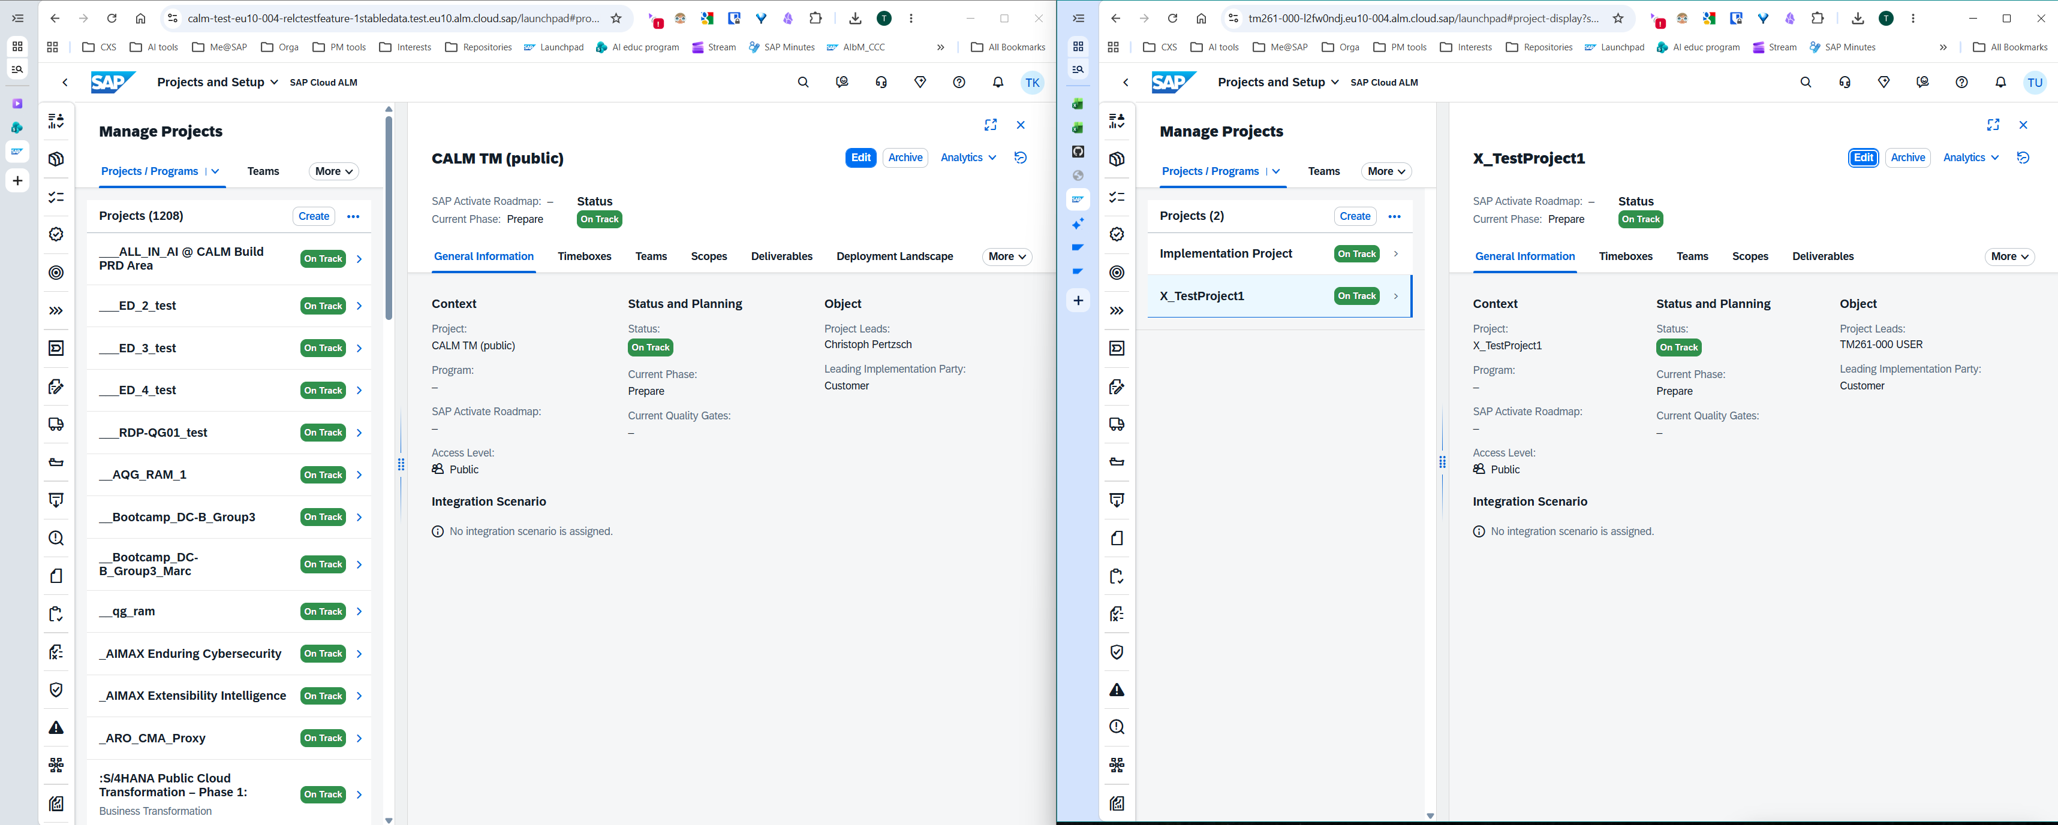
Project
Demo system
TechEd system

Slide 3
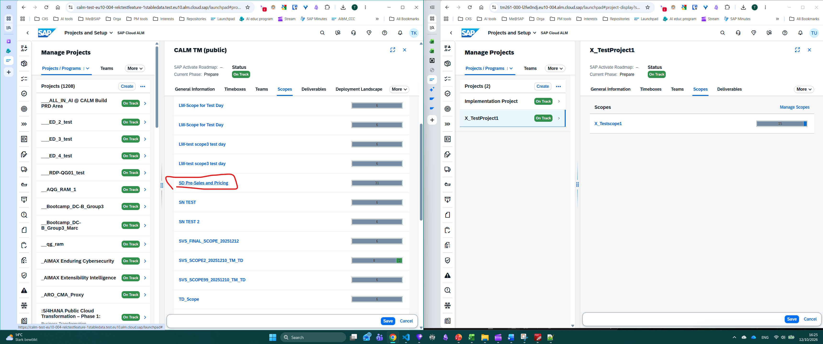
Manage Scopes
Demo
TechEd

Slide 4
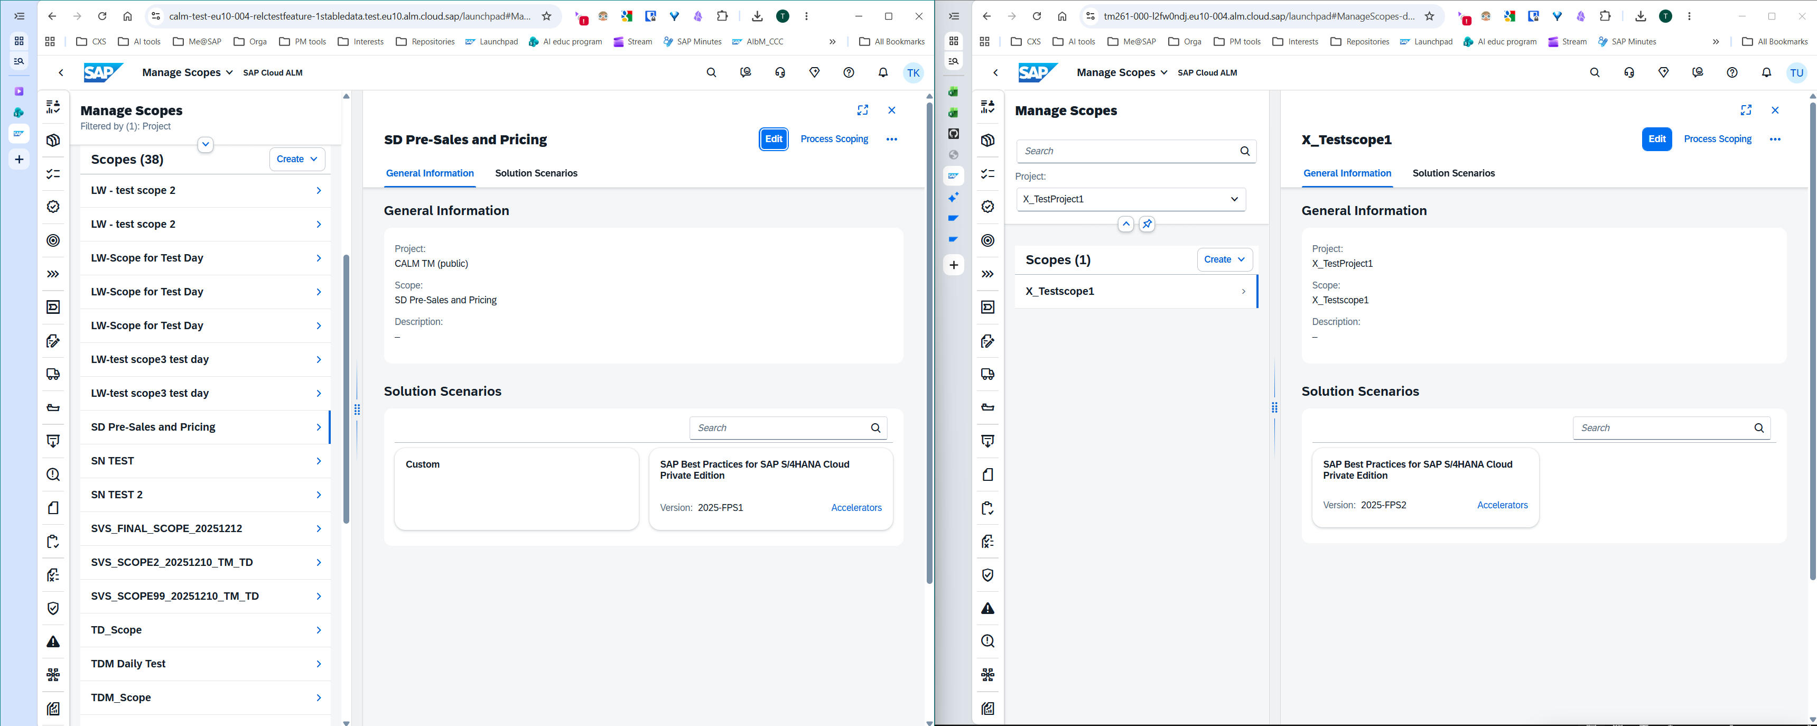
Demo
TechEd

Slide 5
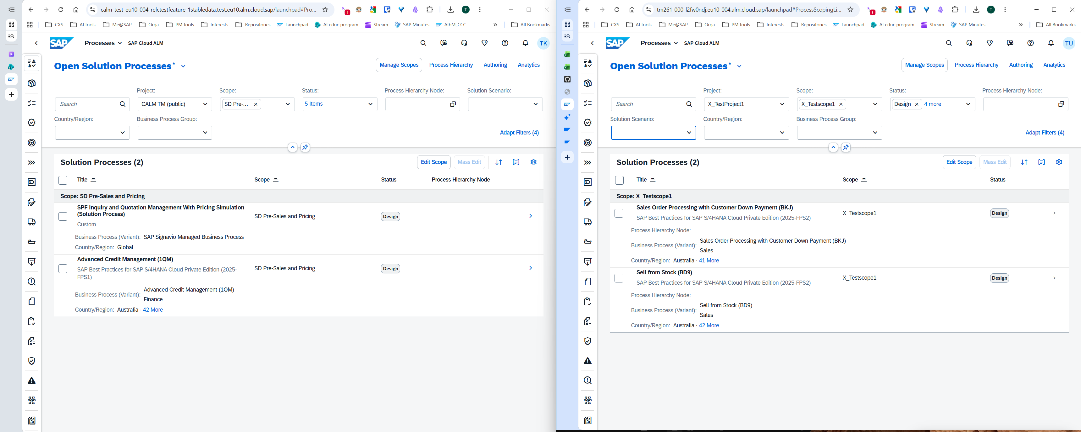
Solution processes
Demo
TechEd

Slide 6
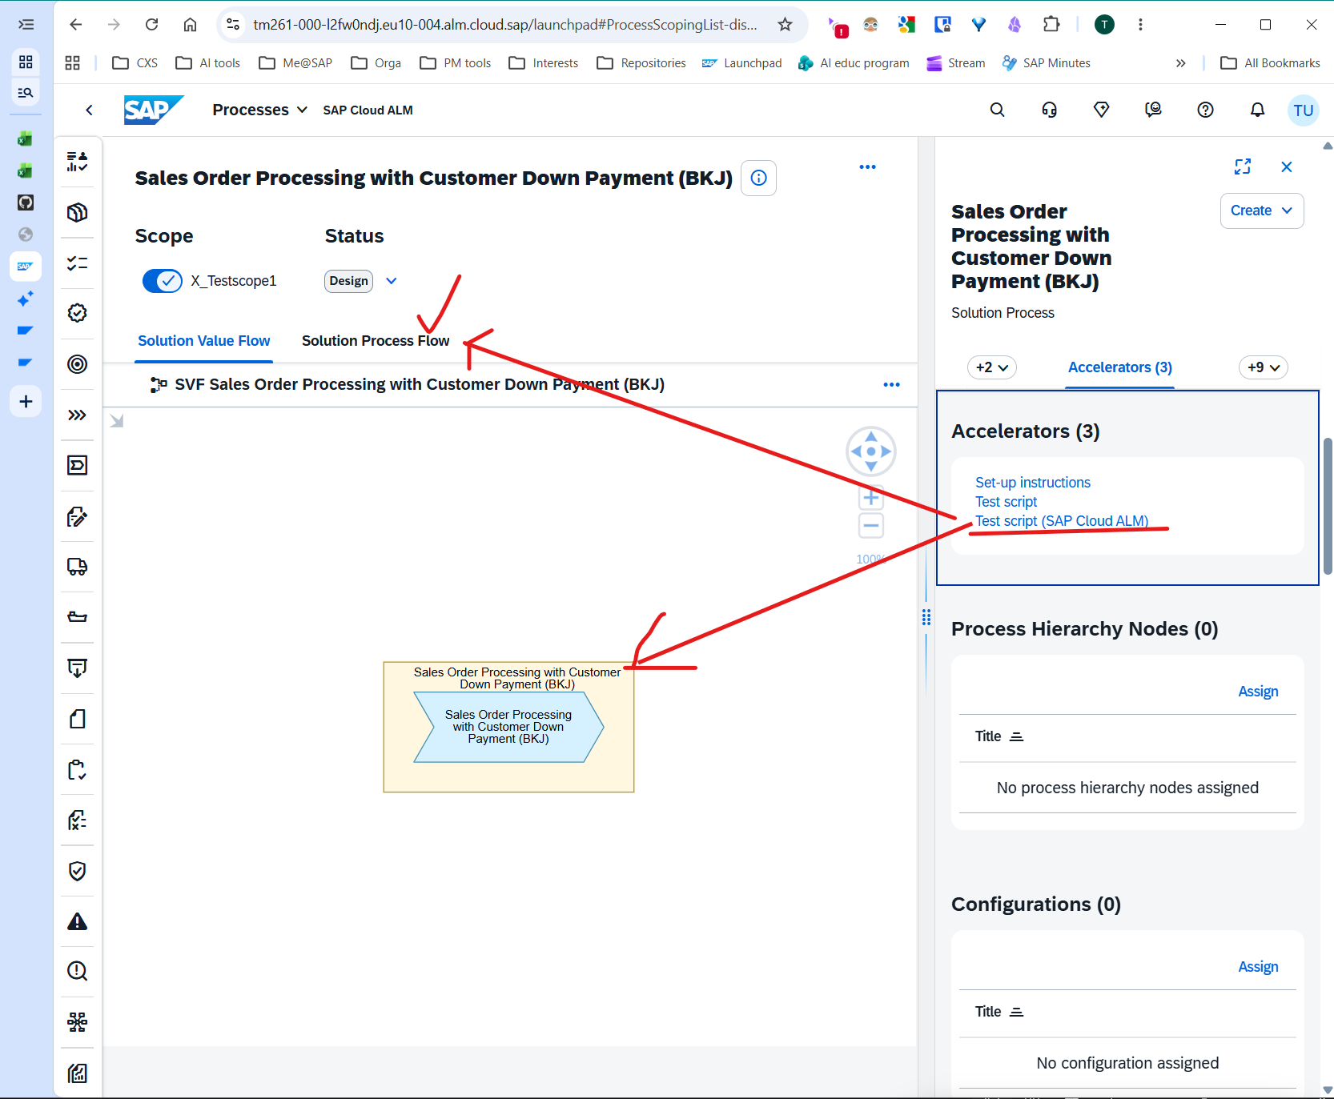
TechEd

Slide 7
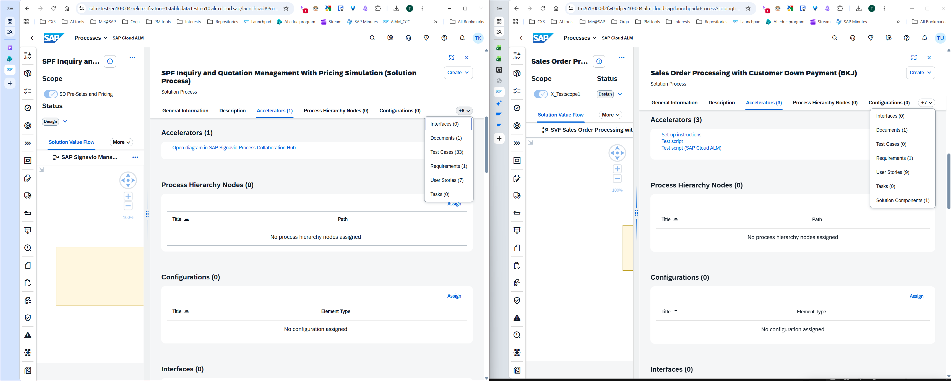
Processes for testing
Demo
TechEd

Slide 8
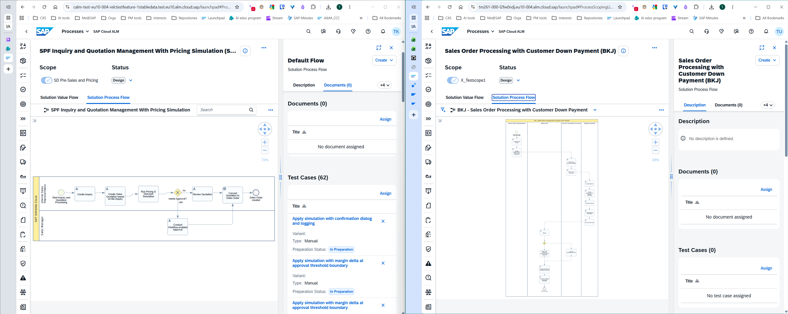
Processes for Testing – BPMN diagram
Demo
TechEd

Slide 9
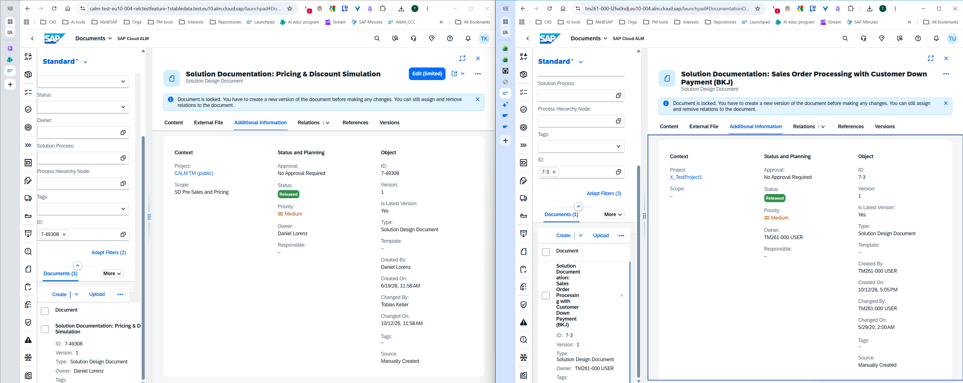
Solution Documentation Documents – Header information
Demo
TechEd

Slide 10
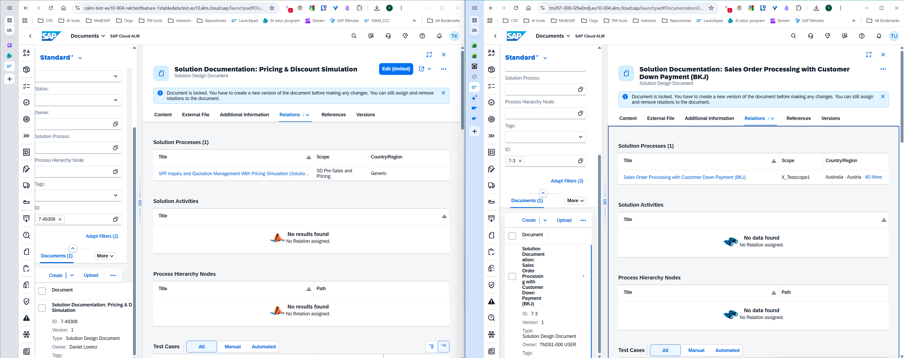
Solution Documentation Documents - Relations
Demo
TechEd

Slide 11
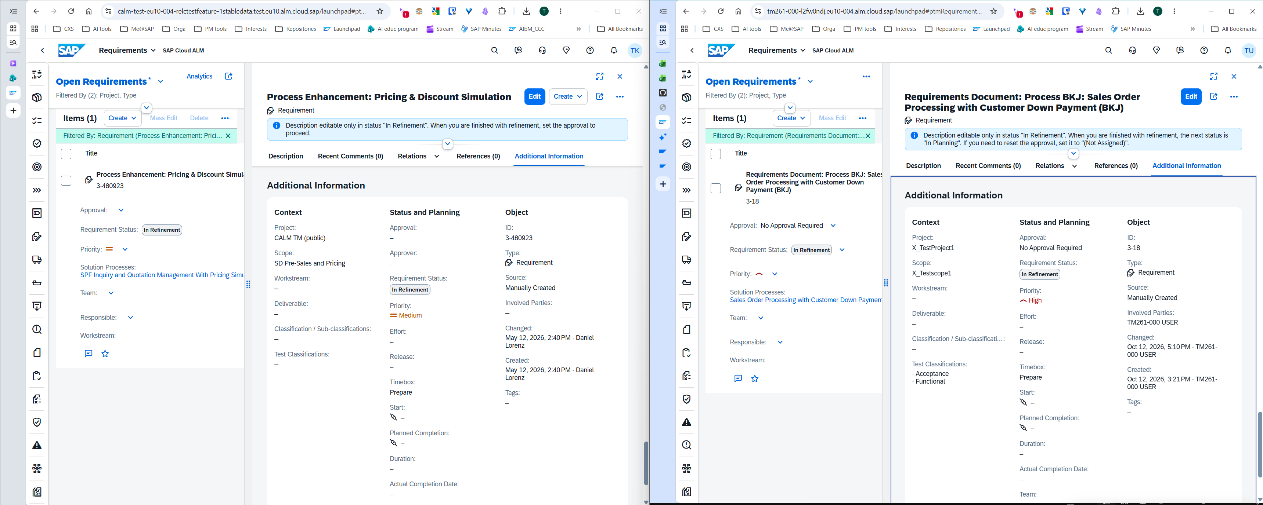
Requirement docs – header data
Demo
TechEd

Slide 12
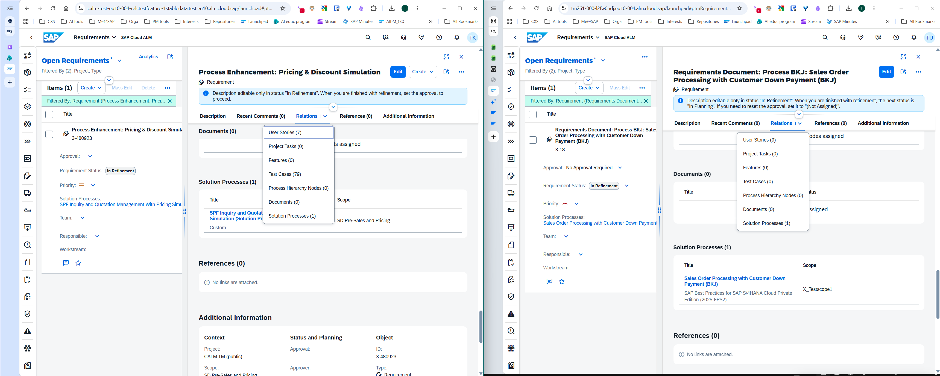
Requirements doc - relations
Demo
TechEd

Slide 13
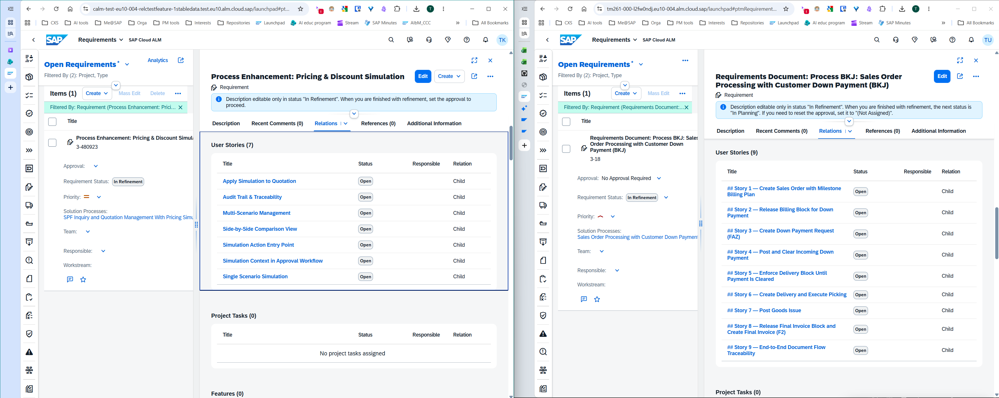
Requirements – related user stories
Demo
TechEd

Slide 15
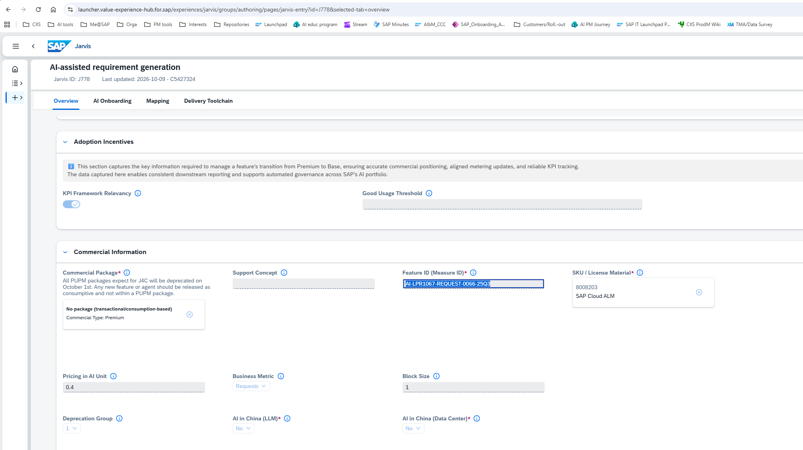
Feature activation in CALM tenant:
1. Get Feature ID from Jarvis (look up by exact name)

Slide 16
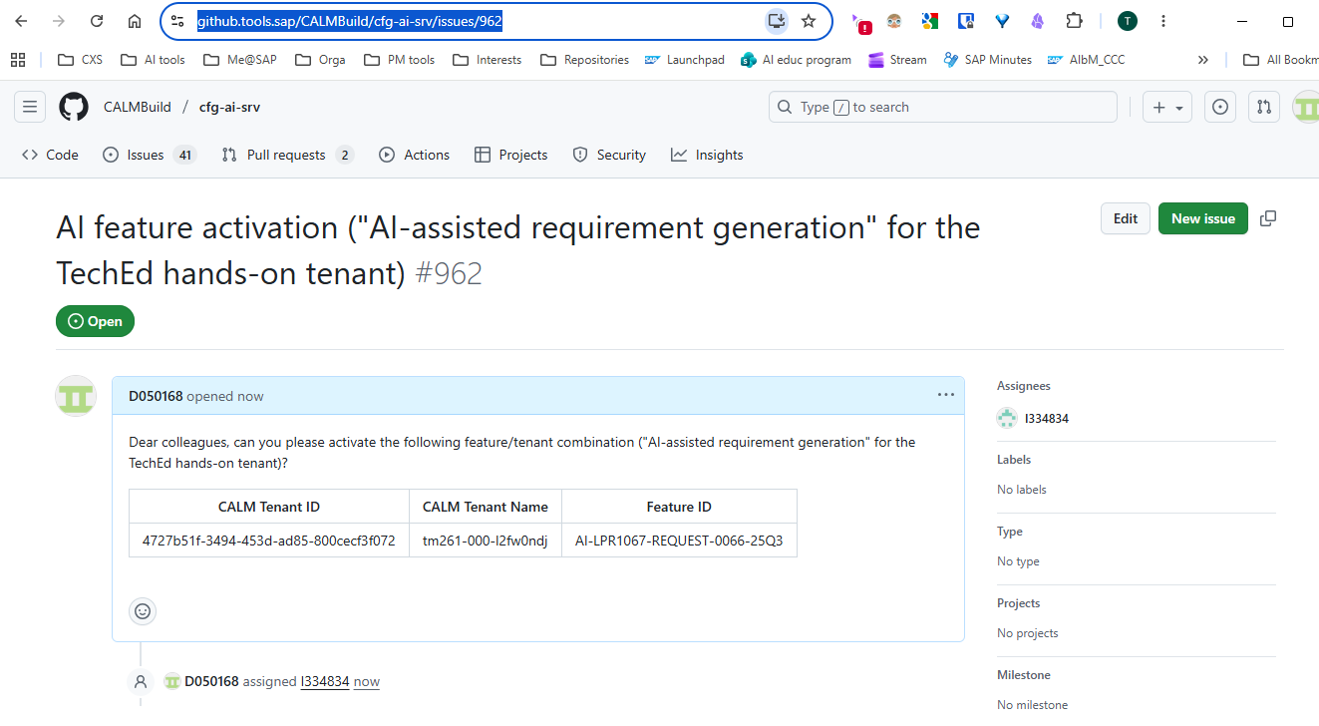
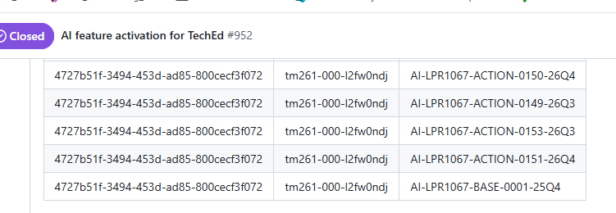
2. Request to activate AI feature in https://github.tools.sap/CALMBuild/cfg-ai-srv/issues/962
https://github.tools.sap/CALMBuild/cfg-ai-srv/issues/952
Jarvis: https://launcher.value-experience-hub.for.sap/experiences/jarvis/groups/list-views/pages/ai-feature-list?selecttab=allfeature

Slide 17
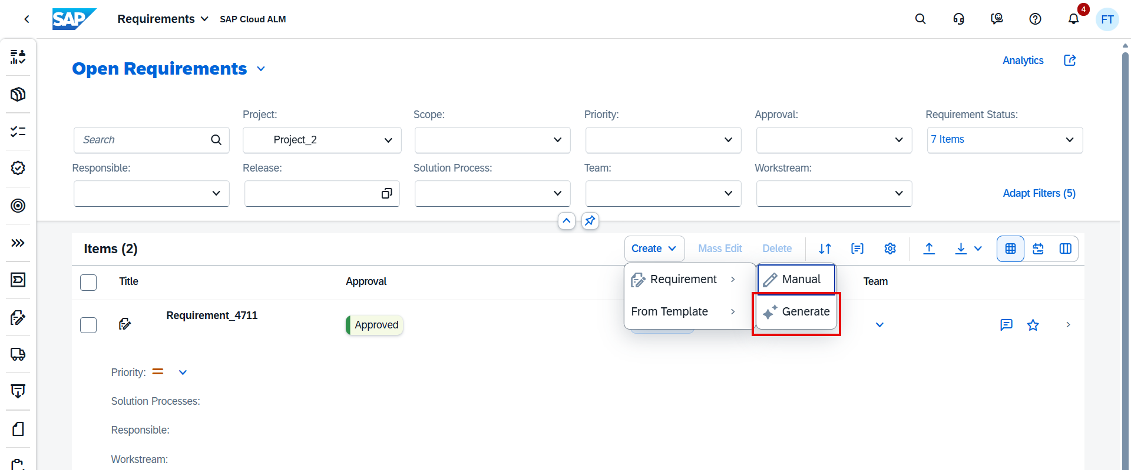
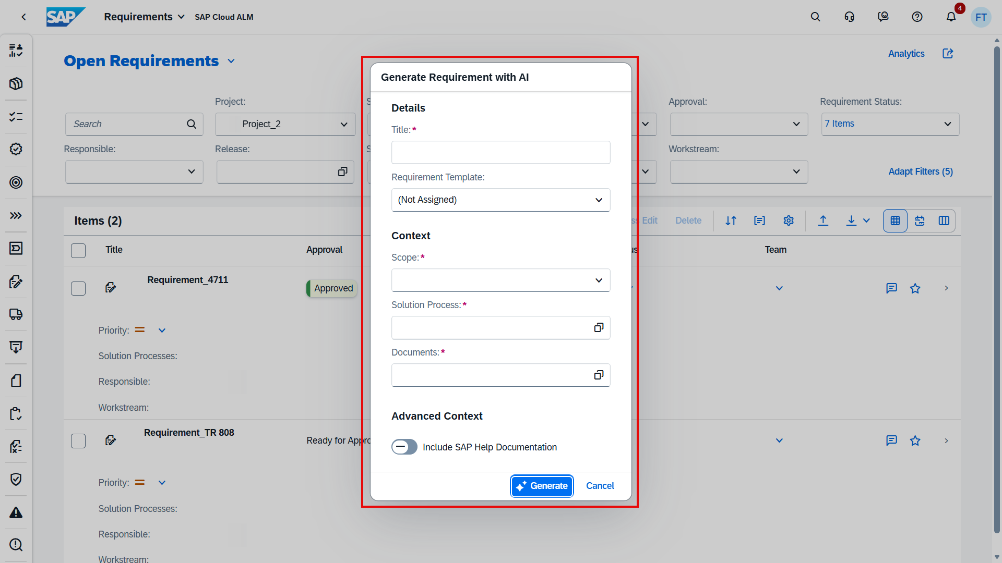
AI-assisted requriement generation https://help.sap.com/docs/cloud-alm/applicationhelp/ai-assisted-requirement-generation?q=requirement+generation
AI-Assisted Requirement Generation
Highlighting results for "requirement generation"
Creation of AI-Generated Requirements
You can use AI-generated requirements in your project. The AI-assisted generation of requirements supports the user in generating requirements based on transcripts and other documentation coming from Fit-to-Standard workshops. You can also include texts from SAP Cloud ALM - Help Portal during the creation. The texts you provided are passed on to the AI model which generates a corresponding requirement text.
For further information, see SAP Discovery Center.
Prerequisites
You have created a document in the Documents app containing the Fit-to-Standard workshop transcript.
Procedure
The following steps have to be completed for every AI-assisted requirement.
Click Create → Requirement → Generate
Enter a title (clear and logical: gets incorporated in the AI prompt to assist AI identifying relevant data).
If available, choose a Requirement Template.
Choose a Scope.
Choose the related Solution Process.
Choose relevant Documents, such as transcripts, process documentation, and meeting minutes. Include the Fit-to-Standard workshop transcript. Make sure to remove any inappropriate or unnecessary text.
If needed, Include SAP Help Documentation.
Click Generate to start the requirement generation. You can also Cancel the requirement generation.
Review and adjust the generated content. Edit or delete any inappropriate or unnecessary data. You can also discard the requirement without saving.
Save the requirement.
The AI-generated text can still be edited after saving.

Slide 18
Object creation (Automation)
Confirmed APIs in the KG
Approaches — ranked
1. CALM Public APIs (recommended) Write a simple Python script that loops 50 times, calling the relevant API endpoints with OAuth credentials. Fast, clean, repeatable, and you can re-run if something goes wrong. The API Hub pages above have the spec — check what's POST-able for your specific object types.
2. Excel bulk import (quick win for test cases) You already have the template — the ToKe001 Excel file references SAP Note 3217691, which documents exactly this. Duplicate 50 rows with participant-specific identifiers, upload once. Limited to test cases, but zero coding required.
3. UI Automation (fallback) Playwright or Selenium if an object type has no API coverage. Slower and more fragile than API calls — only go here if the APIs don't cover what you need.
API | ID | Type | Link
Test Cases | CALM_TM | OData | CALM_TM on API Hub
Test Plans | CALM_TM_PLAN | OData | CALM_TM_PLAN on API Hub
Custom Processes | CALM_PMGE | REST | CALM_PMGE on API Hub
Process Scopes | CALM_PM | REST | CALM_PM on API Hub
Requirements | Requirements API | — | tagged in API Hub

